Slide 1




Wine Analytics (based on Reviews)
Bharathy Carlos Jose Raj

Slide 2

Our Goal Is simple !
Explore the topic of wine for the novice wine drinker!

Slide 3

what makes wine sell?
?
Points
Wine Scale:
< 80 flawed and non-drinkable
80-84 above average’ to ‘good’
85-90 ‘good’ to ‘very good’
90-94 ‘superior’ to ‘exceptional’
95-100 benchmark examples or ‘classic
Price $ 10 -15 for drink at home
$ 20-25 for drink out
Grape variety

Slide 4
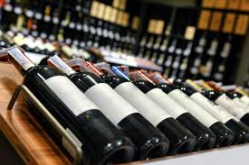
Explore The Data
Data files scraped from twitter and assembled in Kaggle
264 varieties of Wine
Wines tasted and reviewed from all states in US.
more than 50k reviews
All reviews are 80+ points !!.
Price range $5 to $500.
Winery, region and state from where wine is produced
Comments on taste of the wine.

Slide 5

Libraries and tools used !
Sqlite and Sqlalchemy to map the data into DataFrames
Flask API to render the data required to create the maps
D3, Leaflet, Choropleth and MarkerCluster to create maps
HTML/Bootstrap to render the app
Heroku to deploy the app

Slide 6

Taste of our App !!

Slide 7
Final Thoughts
We only have 264 grape varieties available, which is nowhere close to the 10,000+ grape types available across the world !
Our dataset is confined to wines only from US !
Labels & brands, Alcohol content and pH value are important parameters considered when a buyer purchases any alcoholic product ---→ out of scope in our project !
We would love to expand this research further and a complete dataset so we can see the full potential of this visualization

Slide 8


